Slide 1
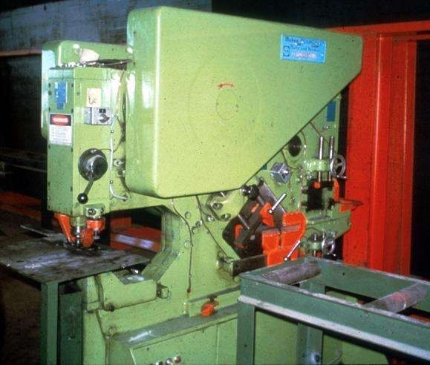
Safe Guarding of Machines Ergonomics

Slide 2
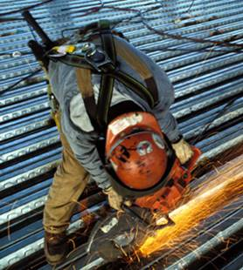
What Is Ergonomics?
Ergonomics (from the Greek word ergon meaning work, and nomoi meaning natural laws), is the science of refining the design of products to optimize them for human use.
The study of people's efficiency in their working environment.
Modify jobs to fit capabilities of people
Reduce MSDs
Repetitive reaching, forceful exertions, bending and lifting, or working with vibrating equipment
Engineering controls
Safe work practices
PPE
Notes:
What is Ergonomics?
Ergonomics is the science of modifying jobs to fit the capabilities of the people who do them. Work-related MSDs result when there is a mismatch between the physical capability of workers and the physical demands of their jobs. Ergonomics helps resolve this mismatch.
Ergonomics helps reduce MSDs that can result when the worker’s job requires repetitive reaching, using forceful exertions, bending and lifting, working with vibrating equipment, or other repetitive motions.
Ergonomic engineering controls may change the design of a work-station, a production line, or the way a job is performed for the purpose of reducing MSDs.
Ergonomics may introduce safe work practices, such as providing alternative tasks or allowing workers to rotate through different types of jobs throughout the day so that their exposure to risk factors is reduced.
Finally, ergonomic personal protective equipment, or PPE, may be used to provide additional protection from MSDs.

Slide 3
Introduction
Crushed hands and arms, severed fingers, blindness - the list of possible machinery-related injuries is as long as it is horrifying. Safeguards are essential for protecting workers from needless and preventable injuries.
A good rule to remember is: Any machine part, function, or process which may cause injury must be safeguarded.
Where the operation of a machine can injure the operator or other workers, the hazard must be controlled or eliminated.

Slide 4
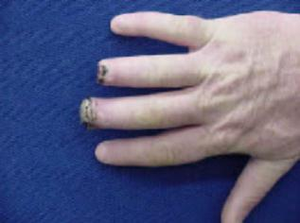
The Problem
Workers who operate and maintain machinery each year suffer approximately
18,000 amputations, lacerations, crushing injuries, and abrasions
800 deaths
OSHA 7100
Notes:
Data from http://www.osha.gov/SLTC/etools/machineguarding/index.html

Slide 5
The Problem: Machinery Associated with Amputations
Mechanical power presses
Power press brakes
Powered and non-powered conveyors
Printing presses
Roll-forming and roll-bending machines
Shearing machines
Food slicers
Meat grinders
Meat-cutting band saws
Drill presses
Milling machines
Grinding machines
Notes:
OSHA 3170

Slide 6
Causes of Machine Accidents
Reaching in to “clear” equipment
Not using Lockout/Tagout
Unauthorized persons doing maintenance using the machines
Missing or loose machine guards

Slide 7
Where Mechanical Hazards Occur
Point of operation
All parts of the machine which move, such as:
flywheels, pulleys, belts, couplings, chains, cranks, gears, etc.
feed mechanisms and auxiliary parts of the machine
In-running nip points

Slide 8
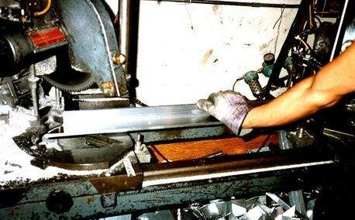
Point of Operation
That point where work is performed on the material, such as cutting, shaping, boring, or forming of stock must be guarded.

Slide 9
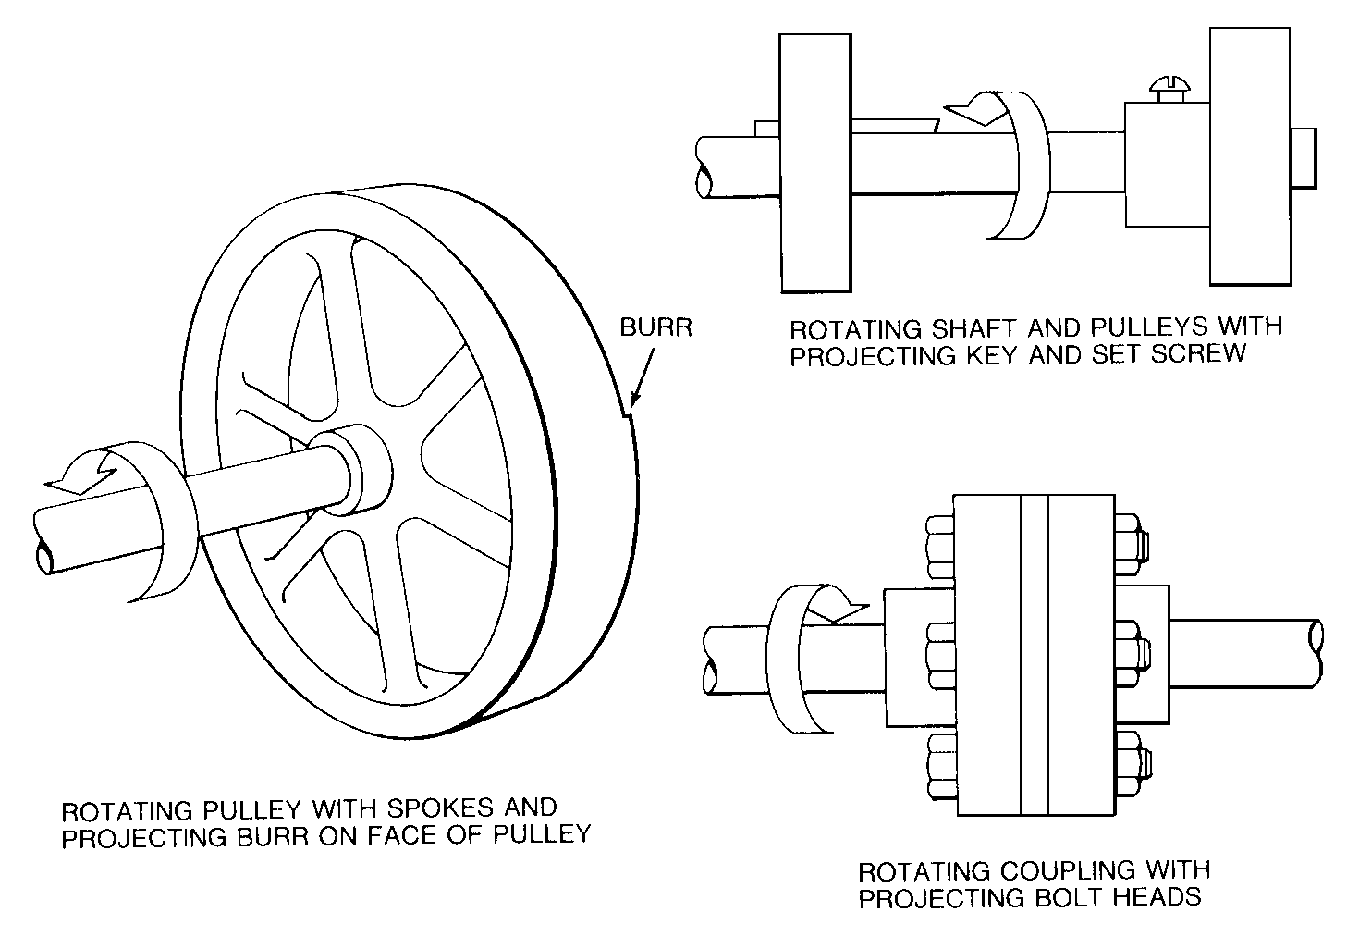
Rotating Parts

Slide 10
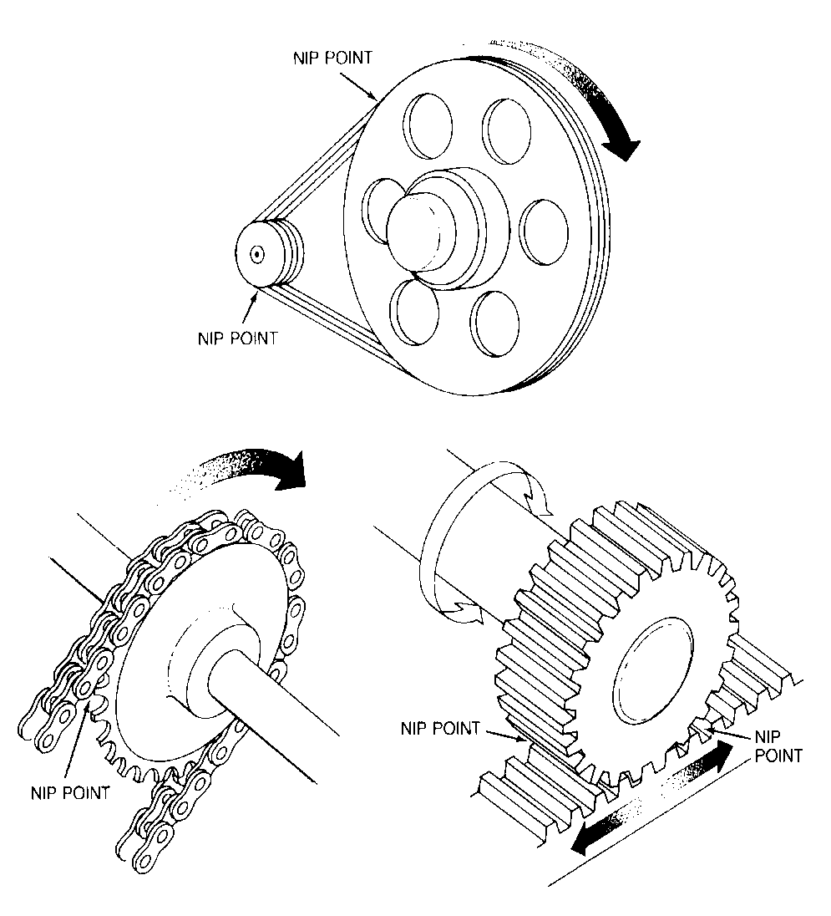
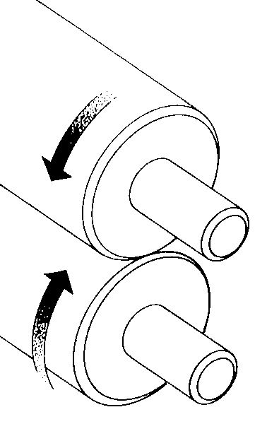
In-Running Nip Points
Rotating cylinders
Belt and pulley
Chain and sprocket
Rack and pinion

Slide 11
Requirements for Safeguards
Prevent contact - prevent worker’s body or clothing from ffrcontacting hazardous moving parts
Secure - firmly secured to machine and not removed
Protect from falling objects - ensure that no objects can fall into moving parts
Create no new hazards - must not have shear points, jagged edges or unfinished surfaces
Create no interference - must not prevent worker from performing the job quickly and comfortably
Allow safe lubrication - if possible, be able to lubricate the machine without removing the safeguards

Slide 12
Methods of Machine Safeguarding
Guards
fixed
interlocked vadjustable
self-adjusting
Devices
presence sensing pullback
restraint
safety controls (tripwire cable, two-hand contol, etc.)
gates
Location/distance
Feeding and ejection methods
automatic and/or semi- automatic feed and ejection
n robots
Miscellaneous aids
d awareness barriers protective shields
d hand-feeding tools
t
r

Slide 13
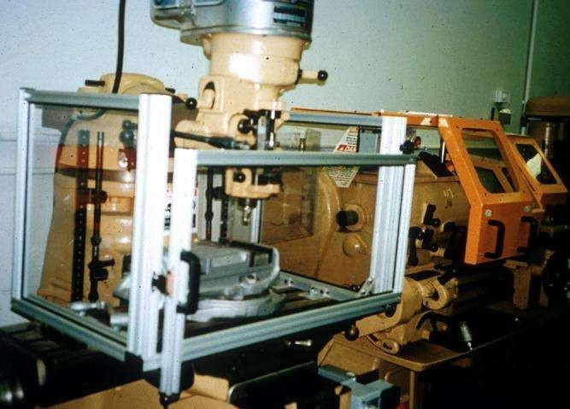
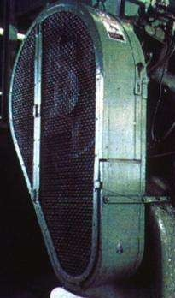
Fixed Guard
Provides a barrier - a permanent part of the machine, preferable to all other types of guards.

Slide 14
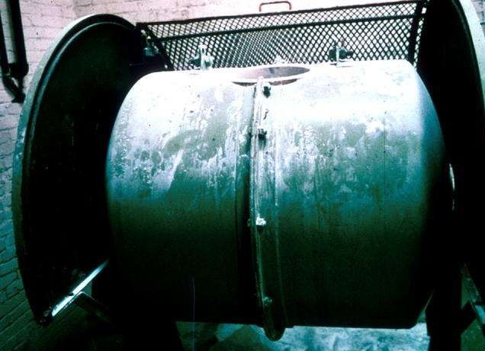
Interlocked Guard
When this type of guard is opened or removed, the tripping mechanism and/or power automatically shuts off or disengages, and the machine cannot cycle or be started until the guard is back in place.
Interlocked guard on revolving drum

Slide 15
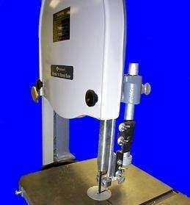
Adjustable Guard
Provides a barrier which may be adjusted to facilitate a variety of production operations.
Bandsaw blade adjustable guard

Slide 16
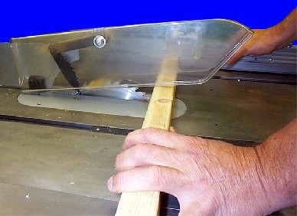
Self-Adjusting Guard
Provides a barrier which moves according to the size of the stock entering the danger area.
Circular table saw self-adjusting guard

Slide 17
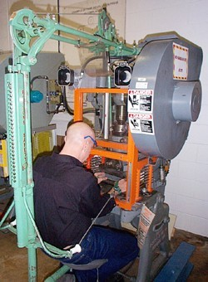
Pullback Device
Utilizes a series of cables attached to the operator’s hands, wrists, and/or arms
Primarily used on machines with stroking action
Allows access to the point of operation when the slide/ram is up
Withdraws hands when the slide/ram begins to descend

Slide 18
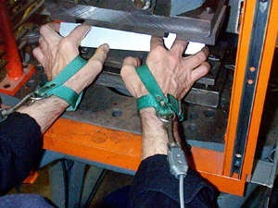
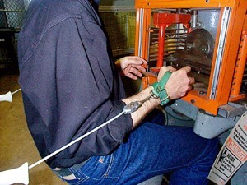
Pullback Device (cont’d)
Hands in die, feeding
Point of operation exposed
Pullback device attached and properly adjusted
Die closed
Hands withdrawn from point of operation by pullback device

Slide 19
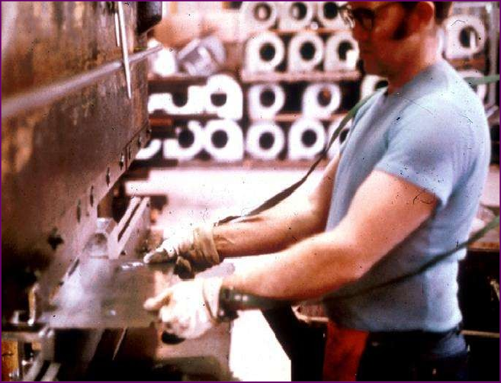
Restraint Device
Uses cables or straps attached to the operator’s hands and a fixed point
Must be adjusted to let the operator’s hands travel within a predetermined safe area
Hand-feeding tools are often necessary if the operation involves placing material into the danger area

Slide 20
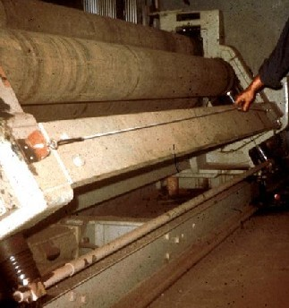
Safety Tripwire Cables
Device located around the perimeter of or near the danger area
Operator must be able to reach the cable to stop the machine

Slide 21
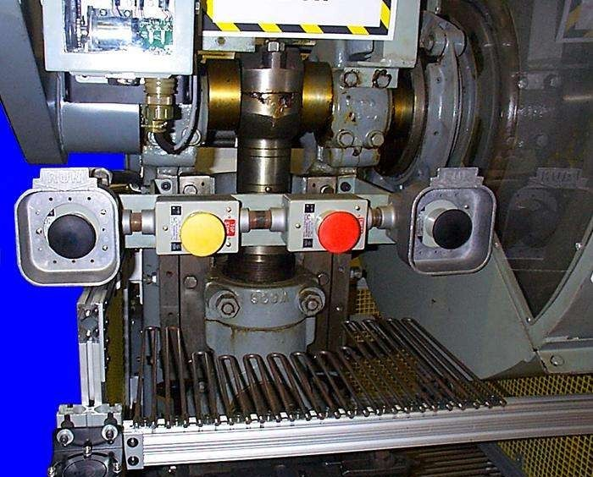
Two-Hand Control
Requires constant, concurrent pressure to activate the machine
The operator’s hands are required to be at a safe location (on control buttons) and at a safe distance from the danger area while the machine completes its closing cycle

Slide 22
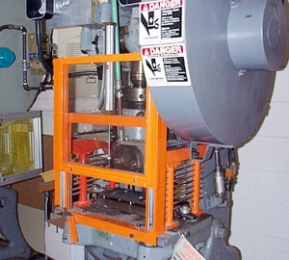
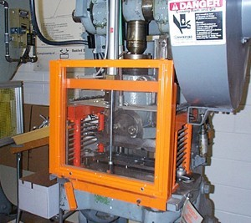
Gate
Movable barrier device which protects the operator at the point of operation before the machine cycle can be started
If the gate does not fully close, machine will not function
Gate Open
Gate Closed

Slide 23
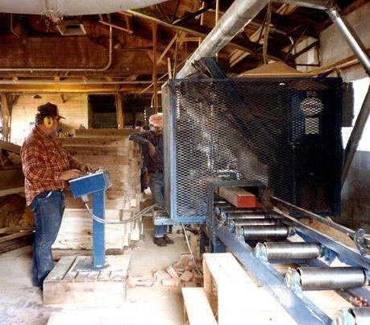
Safeguarding by Location/Distance
Locate the machine or its dangerous moving parts so that they are not accessible or do not present a hazard to a worker during normal operation
Maintain a safe distance from the danger area

Slide 24
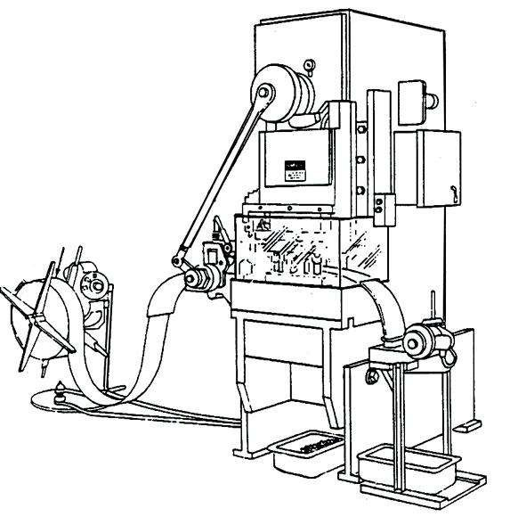
Automatic Feed
(shown on power press)
Transparent Enclosure Guard
Stock Feed Roll
Danger Area
Completed Work

Slide 25
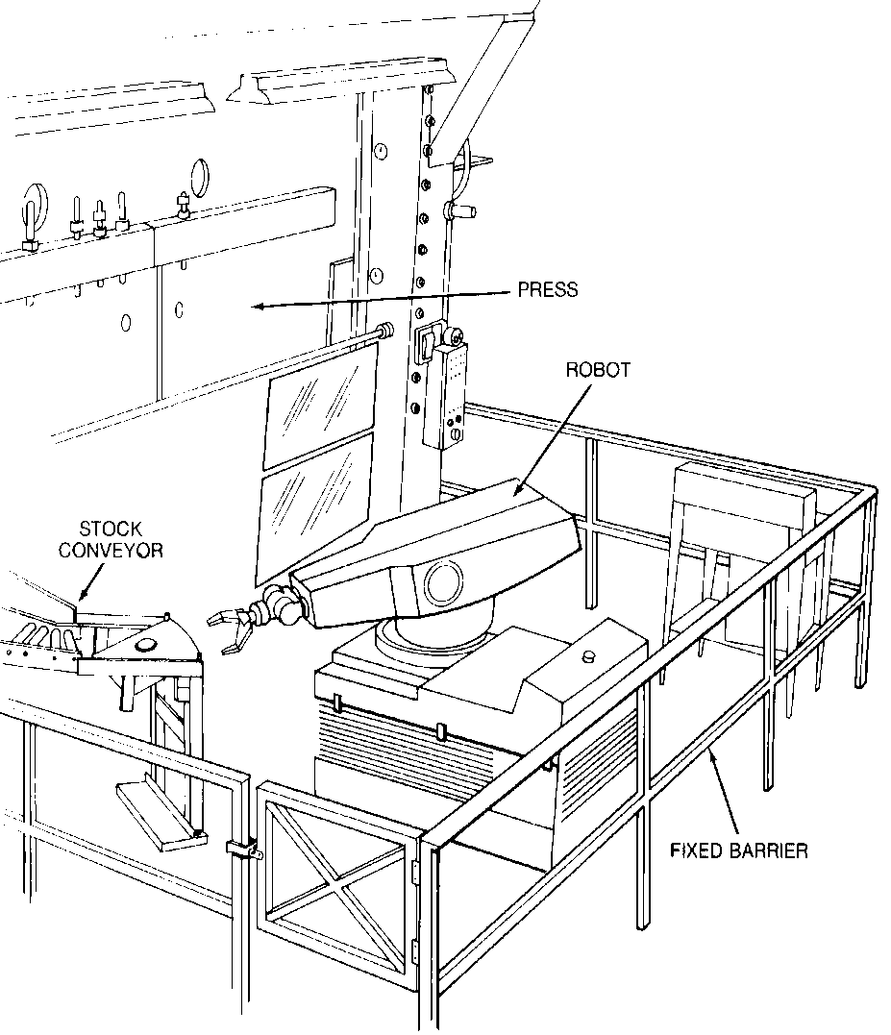
Robots
Machines that load and unload stock, assemble parts, transfer objects, or perform other tasks
Best used in high- production processes requiring repeated routines where they prevent other hazards to employees

Slide 26
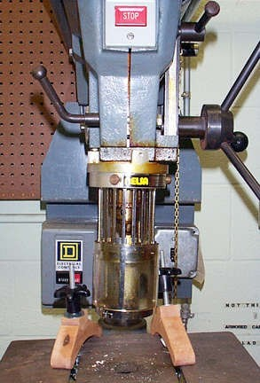
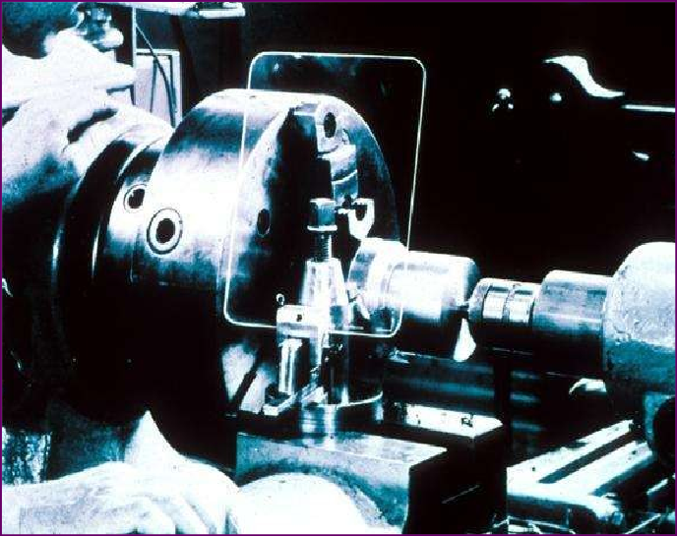
Protective Shields
These do not give complete protection from machine hazards, but do provide some protection from flying particles, splashing cutting oils, or coolants.

Slide 27
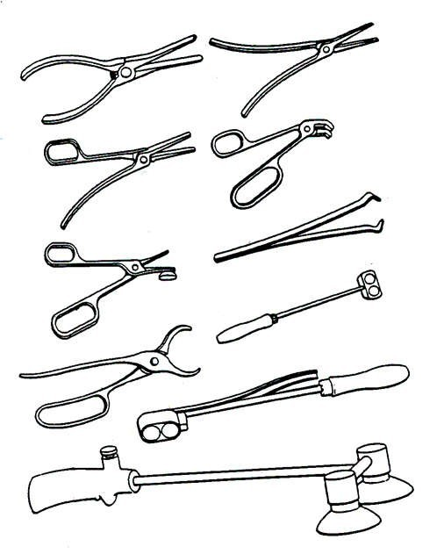
Holding Tools
Used to place and remove stock in the danger area
Not to be used instead of other machine safeguards, but as a supplement

Slide 28
Some Examples of OSHA Machine Guarding Requirements . . . .

Slide 29
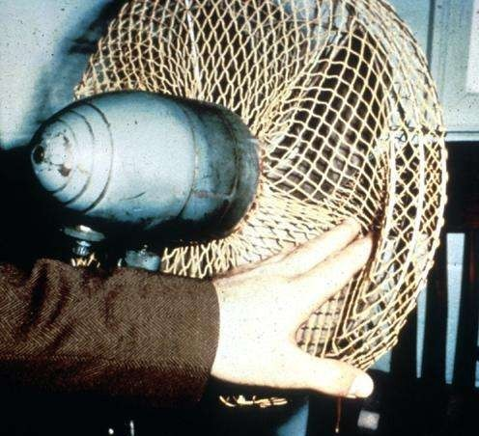
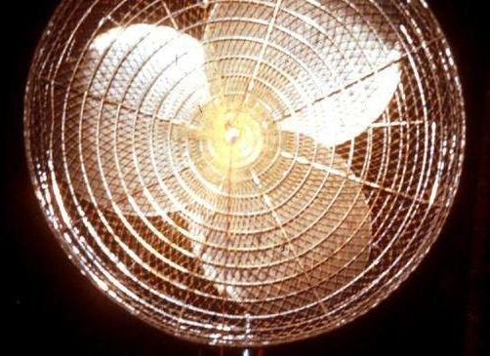
Guarding Fan Blades
When the periphery of the blades of a fan is less than 7 feet above the floor or working level, the blades must be guarded with a guard having openings no larger than 1/2 inch.

Slide 30
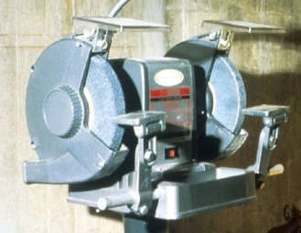
Abrasive Wheel Machinery
Work rests on offhand grinding machines must be kept adjusted closely to the wheel with a maximum opening of 1/8-inch to prevent the work from being jammed between the wheel and the rest, which may result in wheel breakage.

Slide 31
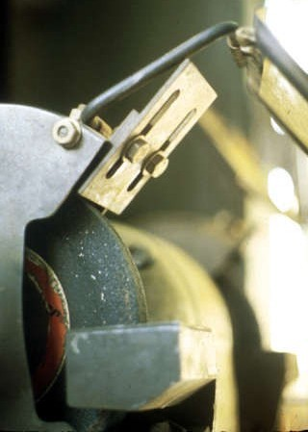
Abrasive Wheel Machinery
The distance between the wheel periphery and the adjustable tongue must never exceed 1/4-inch.

Slide 32
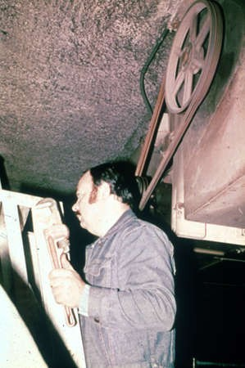
Power-Transmission Apparatus
Power-transmission apparatus (shafting, flywheels, pulleys, belts, chain drives, etc.) less than 7 feet from the floor or working platform must be guarded.
Unguarded belt and pulley

Slide 33
Machine Safety Responsibilities
Management
Ensure all machinery is properly guarded
Supervisors
Train employees on specific guard rules in their areas Ensure machine guards remain in place and are
functional
immediately correct machine guard deficiencies
Employees
Do not remove guards unless machine is locked and tagged
report machine guard problems to supervisors immediately
do not operate equipment unless guards are in place

Slide 34
Machinery: General Safety Principles
Securely fasten equipment to eliminate movement or “walking”
No loose clothing, long hair, jewelry, or gloves around rotating machine parts
Respect machine guards
Keep electrical cords and plugs intact
Inspect machinery before each use
Notes:
1910.212(b) Anchoring fixed machinery. Machines designed for a fixed location shall be securely anchored to prevent walking or moving.

Slide 35
Machinery: General Safety Principles
Do not leave machines running and unattended
Never attend to brush debris from the table surface while the machine is running
An active brake mechanism adds greatly to safety
Easily reached “off” switch increases safety

Slide 36
Training
Operators should receive training on the following:
Hazards associated with particular machines
How the safeguards provide protection and the hazards for which they are intended
How and why to use the safeguards
How and when safeguards can be removed and by whom
What to do if a safeguard is damaged, missing, or unable to provide adequate protection

Slide 37
Benefits of Ergonomics
Decreased injury risk
Increased productivity
Decreased mistakes/rework
Increased efficiency
Decreased lost work days
Decreased turnover
Improved morale

Slide 38
Summary
Safeguards are essential for protecting workers from needless and preventable machinery- related injuries
The point of operation, as well as all parts of the machine that move while the machine is working, must be safeguarded
A good rule to remember is: Any machine part, function, or process which may cause injury must be safeguarded

